Slide 1

SBA 7(a) Loan Jobs Supported Classification Model
By: Rakim Reid
Data Science Flex Final Capstone
June 24, 2023

Slide 2

Project Purpose
The goal of this project is to create a deployable machine learning classification model using SBA 7(a) loan data for Q1 2023.
Classifying the number of jobs supported using the most relevant features.
This product will serve as a tool to help SBA make effective loan application approvals and reduce fraud.

Slide 3
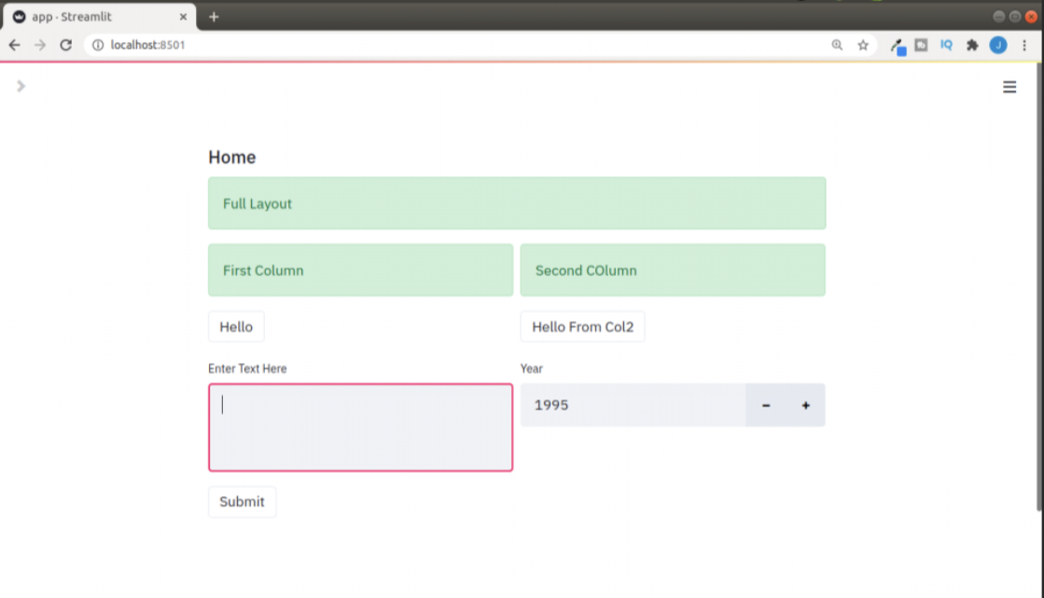
Deployed Web App Layout Example

Slide 4

Who is this for?
Government/SBA officials to classify/predict based on the features how many jobs a business will retain or support on a 7(a) loan.
Potential 7(a) loan applicants to work out what and how much of each factor support a certain number of jobs.

Slide 5

What is the Small Business Administration?
A U.S. federal agency created in 1953.
Helps small business owners and entrepreneurs pursue the American dream.
SBA is the only cabinet-level federal agency fully dedicated to small business and provides counseling, capital, and contracting expertise as the nation’s only go-to resource and voice for small businesses.
Current Leader: Isabella Casillas Guzman

Slide 6
SBA 7(a) Loans
The SBA 7(a) loan program is the agency's most common loan program for small businesses. This type of loan can be used for but not limited to:
Real estate as part of a business purchase
Short- and long-term working capital
Refinancing current business debt
Purchasing and installation of machinery and equipment
Purchasing furniture, fixtures, and supplies

Slide 7

SBA Challenges
Top Management and Performance Challenges Facing the Small Business Administration in Fiscal Year 2023 report
6 out of 8 challenges dealt with participant eligibility, preventing fraud, and oversight.
Challenge 1: Economic Relief programs (especially during COVID) shed light on fraud.
Challenge 4: Risk Management of High-Risk Lending Participants

Slide 8

Tools Used
Excel/CSV file
Python
Power BI

Slide 9

Dataset Structure
1 dataset
32 columns
168,211 rows

Slide 10
Original Features
SBA Guaranteed Approval
Gross Approval
Initial Interest Rate
Term in Months
Business Type --> split into 0 and 1 binary variables
Business Age --> split into 0 and 1 binary variables
Paid in Full: make binary, yes or no
Revolver Status --> already 0 and 1 binary variable
Loan Status --> filter out cancelled loans and split into 0 and 1 binary variables
Approval Fiscal Year --> 2020 or not / or filter out for one particular fiscal year

Slide 11
Selected Features
Gross Approval
Initial Interest Rate
Term in Months
Revolver Status
Startup (yes or no, 1 or 0)

Slide 12
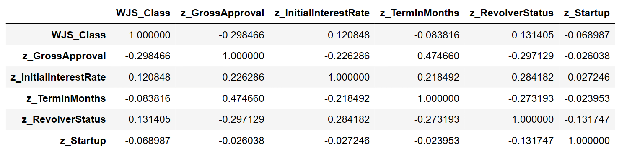





Selected Features Correlation Table

Slide 13
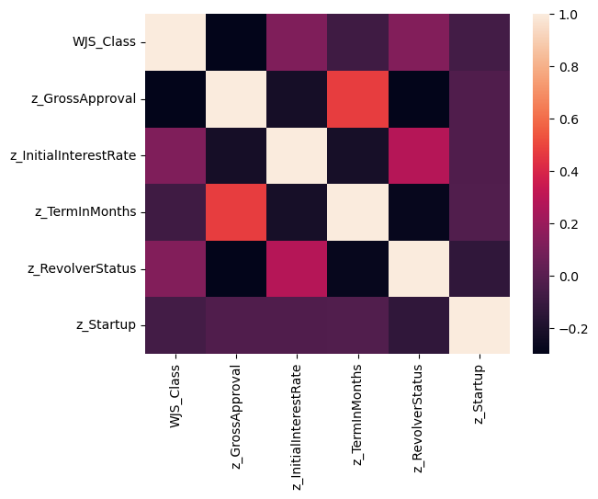
Selected Features Correlation Heatmap

Slide 14
Feature Processing
Winsorized the data – flattened the top 15% of job supported
Removed 0 jobs supported
Resulting jobs supported 1 – 20 jobs. Represents 85% of data.

Slide 15
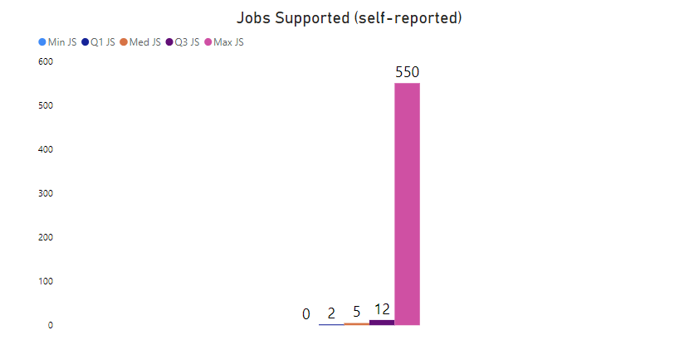
Exploratory Data Analysis

Slide 16
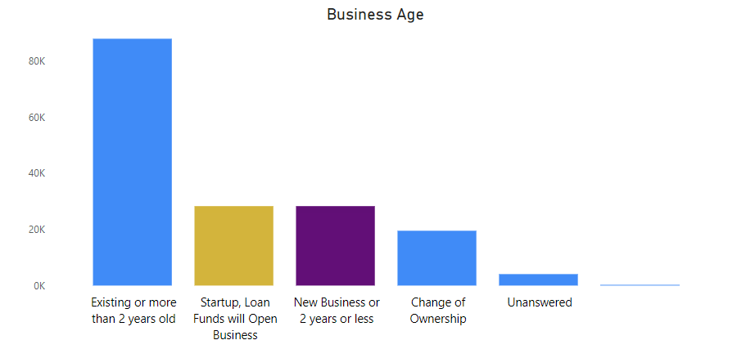
Exploratory Data Analysis

Slide 17
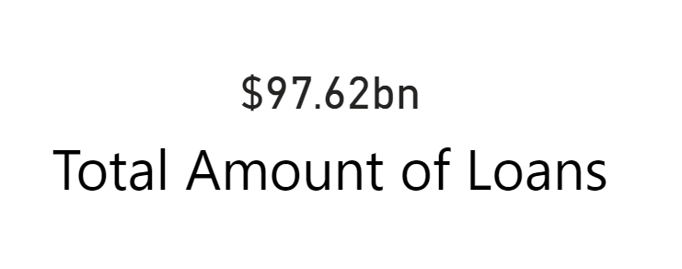
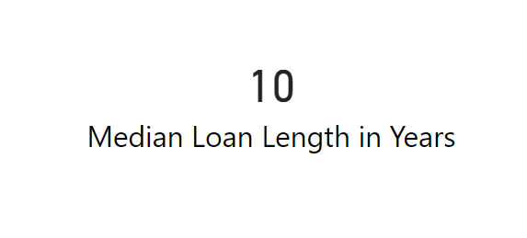
Exploratory Data Analysis

Slide 18
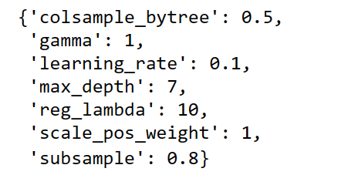
Model Chosen: XGBoost (tuned)
Base accuracy: 74.519%
Tuned accuracy: 75.79% and ran faster than other models!

Slide 19
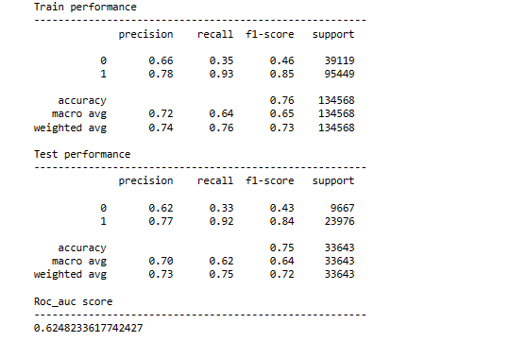
XGBoost
Model accuracy: 75%
No parameter alterations/base model

Slide 20
Models Evaluated
Random Forest Classifier
Decision Tree Classifier
XGBoost Classifier
Extra Trees Classifier
KNN Classifier
Deep Learning Classifier
* AdaBoost Classifier / Gradient Boosting Classifier / Voting Classifier

Slide 21
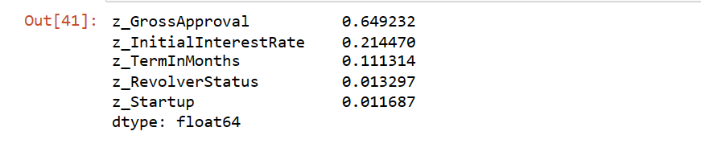
Random Forest
Model Accuracy: 71.87%
n_estimators = 200, max_depth = None, min_samples_split = 3, max_features = auto, and random_state = 0
z_GrossApproval is the most important feature in this model, followed by Initial Interest Rate and Term in Months. Binary features like z_Revolver Status and z_Startup played less of a role. But removing them from the models for this project lowered each models' accuracy. So, we are keeping them in.

Slide 22
Decision Tree
Model accuracy: 72.73%
Criterion: gini, max_depth = 3, random_state = 0
Training set score: 72.82% / Test Set Score: 72.73% - No overfitting since the training and test scores were close

Slide 23

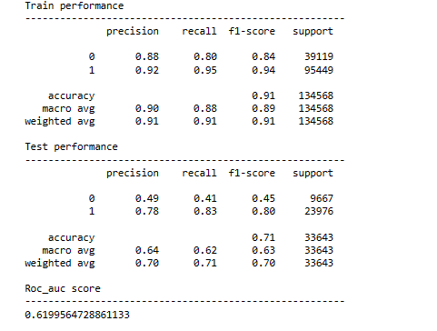
Extra Trees Classifier
Model accuracy: 71%

Slide 24
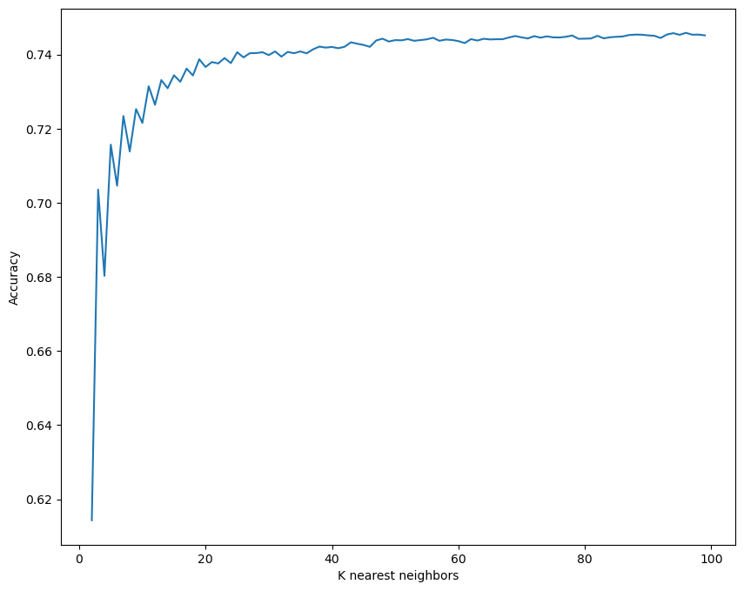
KNN Classifier
Untuned model accuracy: 61.43%
Set K = 100 based on chart
Model accuracy increased to 74.53%

Slide 25
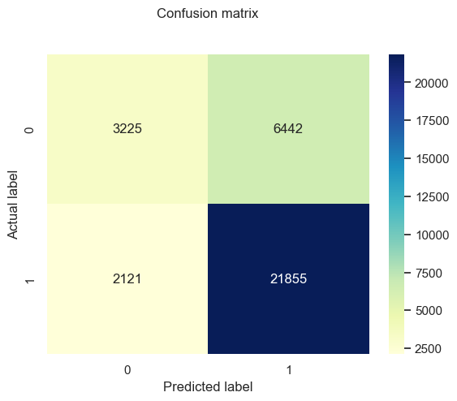
Deep Learning Classifier
Model accuracy: 74.54%
Train score: 0.51
Train accuracy: 74.5%
Test score: 0.51
Train score: 0.7454
Area under ROC curve: 0.7555

Slide 26

Conclusion
Classification models may yield better predictive accuracy than regressions for this type of dataset. Tree-based models and deep learning techniques tend to produce better results. This is probably due to how these types of models mimic how humans think.
Supervised learning models are a potentially viable approach to classify the number of jobs supported.
This will help solve a perennial problem in federal government: managing the cost of programs and getting the most value of each program.

Slide 27
Future Projects
Perform
Perform additional feature engineering to increase model accuracy. Adding data from prior years may improve model accuracy. The next step afterwards would be to deploy the model online.
Build
Build this project with a regression model to predict actual job supported numbers
Explore
Explore geographic features and location impact on model performance or predict loan location.

Slide 28

Thank you!

